Slide 1
Today’s Agenda
Prime and Essential Implicant
Don’t Care Conditions
Two Level Gate Implementations

Slide 2
Implicant and Prime Implicants
Implicant: a group of one more k-map cells.
Prime Implicant: an implicant that is not subset of another implicant.
Essential Prime Implicant: If minterm is part of only one prime implicant then that prime implicant is said to be essential prime implicant.

Slide 3
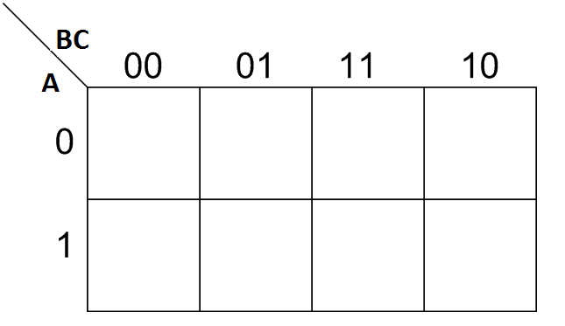
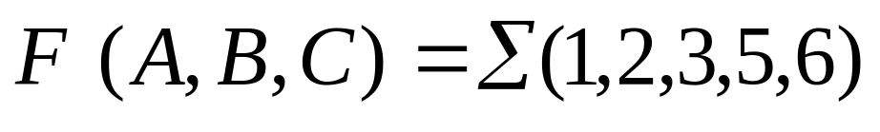
Three-Variable K-Map Example
Step 1: Plot the K-map
1
1
1
1
1
1

Slide 4
Three-Variable K-Map Example
Step 2: Circle ALL Prime Implicants
PI
PI
1
1
1
1
PI
1
1
PI

Slide 5
Three-Variable K-Map Example
Step 3: Identify Essential Prime Implicants
PI
PI
1
1
1
1
EPI
1
1
EPI

Slide 6
Three-Variable K-Map Example
Step 3: Identify Essential Prime Implicants
1
1
1
1
B’C
1
1
BC’

Slide 7
Three-Variable K-Map Example
Step 4: Select minimum subset of remaining
Prime Implicants to complete the cover.
A’C
First Simplified Expression
F= B’C+BC’+ A’C
1
1
1
1
1
B’C
1
BC’

Slide 8
Three-Variable K-Map Example
Step 4: Select minimum subset of remaining
Prime Implicants to complete the cover.
A’B
Second Simplified Expression
F= B’C+BC’+ A’B
1
1
1
1
1
B’C
1
BC’

Slide 9
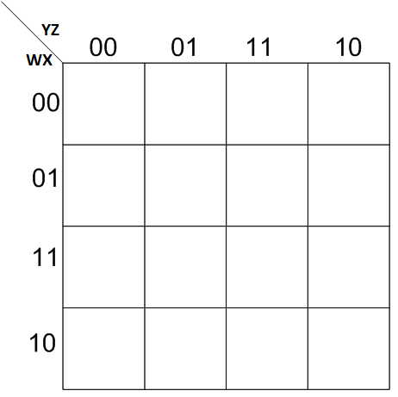
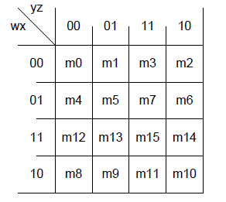
Four Variable K-Map Example
Determine all prime implicants and also find which of them are essential.
Determine all possible simplified expression of function.
1
1
1
1
1
1
1
1
1
1

Slide 10
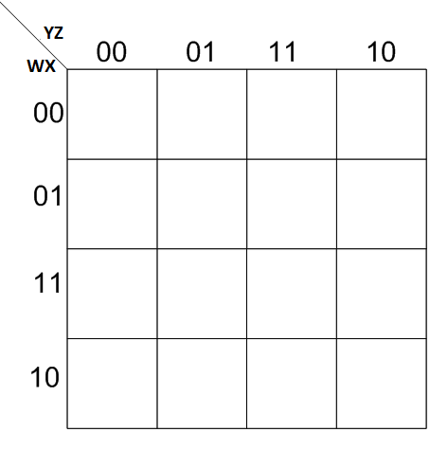
Four Variable K-Map Example
Step 2: Circle ALL Prime Implicants
PI
PI
1
1
1
1
1
1
1
1
1
1
1
1
PI
1
1
1
1
PI
1
1
1
1

Slide 11
Four Variable K-Map Example
Step 3: Identify Essential Prime Implicants
EPI
PI
1
1
1
1
1
1
1
1
1
1
1
1
PI
1
1
1
1
EPI
1
1
1
1

Slide 12
Four Variable K-Map Example
Step 3: Identify Essential Prime Implicants
X’Z’
1
1
1
1
1
1
1
1
XZ
1
1

Slide 13
Four Variable K-Map Example
Step 4: Select minimum subset of remaining
Prime Implicants to complete the cover.
X’Z’
First Simplified Expression
1
1
F= XZ + X’Z’ + W’X
1
1
1
1
1
1
W’X
XZ
1
1

Slide 14
Four Variable K-Map Example
Step 4: Select minimum subset of remaining
Prime Implicants to complete the cover.
X’Z’
Second Simplified Expression
1
1
F= XZ + X’Z’ + W’Z’
1
1
1
1
1
1
W’Z’
XZ
1
1

Slide 15


Product of Sum Simplification
Let F be a function → F’ = (all minterms not in F)
F= (all minterms not in F)’
Therefore one can obtain Product of Sum (POS) by:
Group all 0’s on K-map.
Use the De-morgan theorem to obtain POS expression.

Slide 16

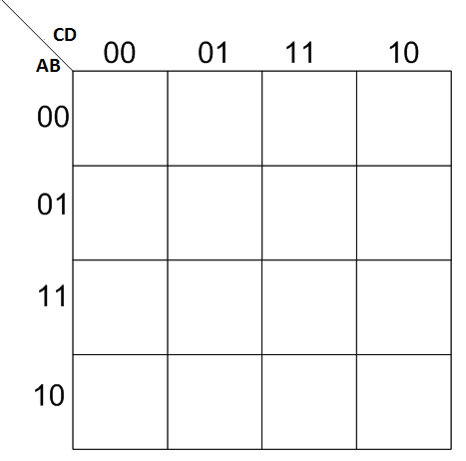
Example
Simplify the Boolean function into product of sum form.
CD
BD’
0
0
0
0
F’= AB + CD + BD’
AB
0
0
0
0
F=( AB)’ (CD )’(BD’)’
F=(A’+B’) (C’+D’) (B’+D)
0

Slide 17
Don’t Care Conditions:
Some time not all the values of function is defined.
Some input conditions will never occur.
We don’t care what the output for that input condition.
In these cases, we can choose the output to be either ‘0’ or ‘1’.
Don’t cares are plotted as ‘X’ in K-map.

Slide 18


Example:
W’X’Z
X
1
1
X
X
1
1
YZ
F= W’X’Z + YZ
1

Slide 19
Example:
W’X’
X
1
1
X
X
1
1
YZ
F= W’X’ + YZ
1

Slide 20
Two Level Gate Implementation:
Boolean function represented in standard/canonical SOP and POS can be implemented using two level gate implementation procedure
Examples:
a) F1 = x+y’z
b) F2= (A’+B’)(C’+D’)(B’+D)
23

Slide 21
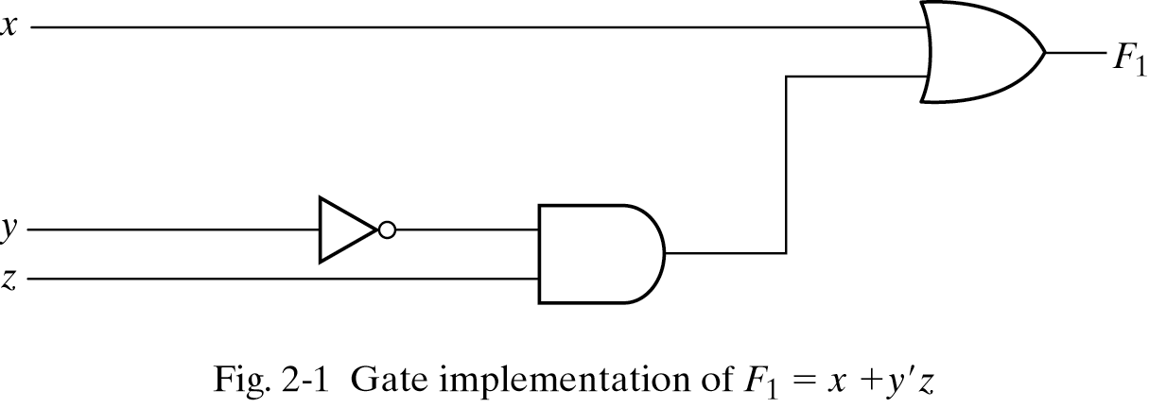
Implementation of Boolean Function Using AND, OR and NOT Gates:

Slide 22
Home Work
3.1,3.3,3.5,3.7,3.9,3.10,3.11,3.12

